Slide 1

CSE- 321
Software Engineering
Lecture : 12 Software design
Fahad Ahmed
Lecturer, Dept. of CSE
E-mail: fahadahmed@uap-bd.edu

Slide 2
Layered architecture
Have you ever wondered how Google makes Gmail work in different languages all over the world? Users can use Gmail every day in English, Spanish, French, Russian, and many more languages.
Did Google develop different Gmail applications for each country? Of course not.
They developed an internal version that does all the message processing, and then developed different external user interfaces that work in many languages.

Slide 3
Layered architecture
Google developed the Gmail application in different layers:
There is an internal layer that does all the processing.
There is an external layer that communicates with the users in their language.
There is also another layer that interacts with a database where user email messages are stored (millions or maybe billions).
Gmail is divided into at least three layers, every one of them has a mission, and they exist separately to handle different processes at different levels. It is an excellent example of a layered architecture.

Slide 4
Layered architecture
Used to model the interfacing of sub-systems.
Organizes the system into a set of layers (or abstract machines) each of which provide a set of services.
Supports the incremental development of sub-systems in different layers. When a layer interface changes, only the adjacent layer is affected.
However, often artificial to structure systems in this way.

Slide 5
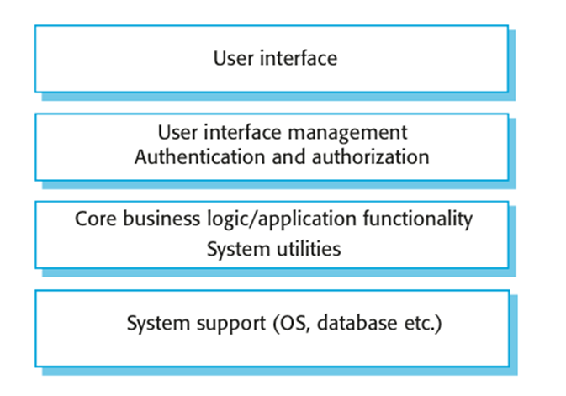
A generic layered architecture

Slide 6
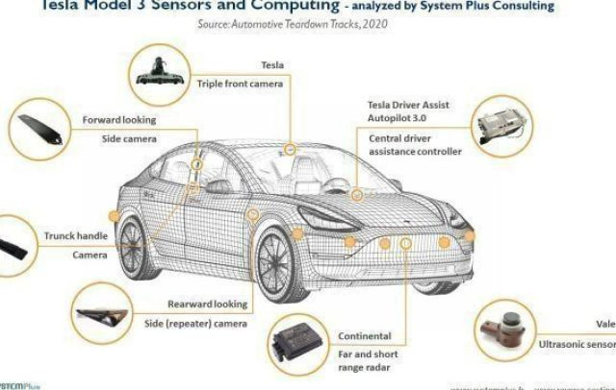
Layered architecture
Real-World Example
Tesla Control Module (tesla.com):Control system for self- driving vehicles
Waymo software (waymo.com)

Slide 7
Case-Study: Solving a Business Problem With Layered Architecture
Amaze is a project management software company.
Their product is sold globally with a monthly pay-per-user model and widely known among the project management community for being easy to use and able to operate on many different devices (PCs, Notebooks, laptops, tablets, iPhones, iPads, and Android phones).

Slide 8
Case-Study: Solving a Business Problem With Layered Architecture
What’s the Business Problem?
The business problem is very straightforward: Amaze must work on any popular device on the market and be able to support future devices.
There must be only one version of the software for all devices. No special cases, no exceptions allowed.
So to sum up:
We know that users have different devices.
There must be only one software application because the company wants to have low software maintenance costs.
When new device launches, we do not want to change the whole software product.

Slide 9
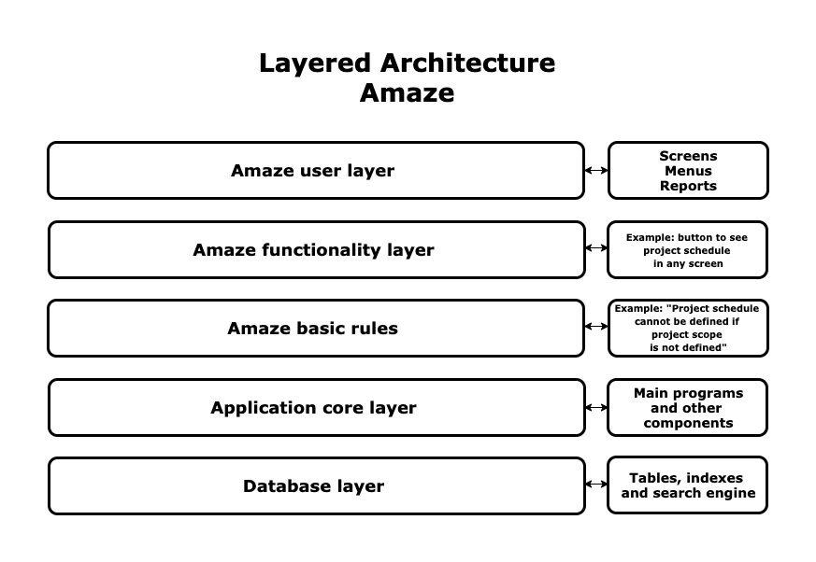
Case-Study: Solving a Business Problem With Layered Architecture
What's the Solution?

Slide 10
Case-Study: Solving a Business Problem With Layered Architecture
In our case, the Amaze basic rules layer is critical. This layer contains rules that determine the behaviour of the whole application, such as, "You can create a project schedule only if the project scope is defined."
The product's intelligence is in this layer: all special features that come from decades of experience in projects are developed there. The application core layer will be the most significant part of the application code.

Slide 11
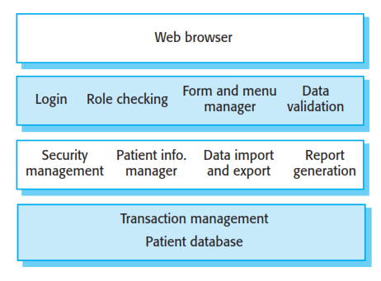
The architecture of the Mentcare system
This system maintains and manages details of patients who are consulting specialist doctors about mental health problems.

Slide 12
The architecture of the Mentcare system
The top layer is a browser-based user interface.
2. The second layer provides the user interface functionality that is delivered through the web browser. It includes components to allow users to log-in to the system and checking components that ensure that the operations they use are allowed by their role. This layer includes form and menu management components that present information to users, and data validation components that check information consistency.
3. The third layer implements the functionality of the system and provides components that implement system security, patient information creation and updating, import and export of patient data from other databases, and report generators that create management reports.
4. Finally, the lowest layer, which is built using a commercial database management system, provides transaction management and persistent data storage.

Slide 13
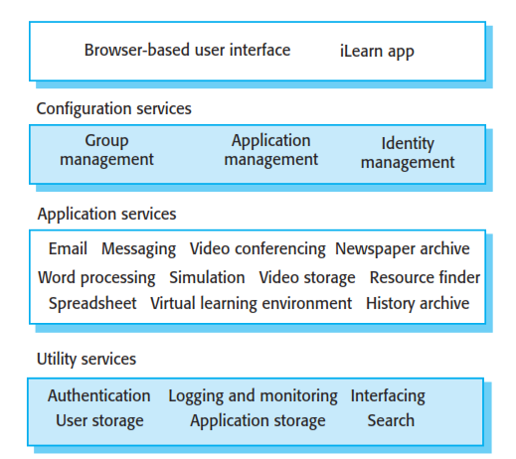
The architecture of the iLearn system

Slide 14
Layered architecture
There are several advantages to using layered architecture:
Layers are autonomous: A group of changes in one layer does not affect the others. This is good because we can increase the functionality of a layer, for example, making an application that works only on PCs to work on phones and tablets, without having to rewrite the whole application.
Layers allow better system customization.
There are also a few key disadvantages:
Layers make an application more difficult to maintain. Each change requires analysis.
Layers may affect application performance because they create overhead in execution: each layer in the upper levels must connect to those in the lower levels for each operation in the system.

Slide 15
Control styles
Are concerned with the control flow between sub-systems. Distinct from the system decomposition model.
Centralised control
One sub-system has overall responsibility for control and starts and stops other sub-systems.
Event-based control
Each sub-system can respond to externally generated events from other sub-systems or the system’s environment.

Slide 16
Centralized control
A control sub-system takes responsibility for managing the execution of other sub-systems.
Call-return model
Top-down subroutine model where control starts at the top of a subroutine hierarchy and moves downwards. Applicable to sequential systems.
Manager model
Applicable to concurrent systems. One system component controls the stopping, starting and coordination of other system processes. Can be implemented in sequential systems as a case statement.

Slide 17
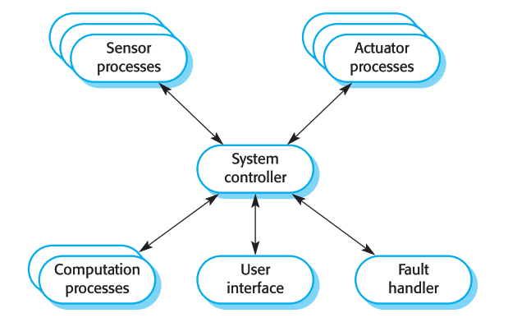
A centralized control model for a real-time system
Centralised control

Slide 18
The repository model
Sub-systems must exchange data. This may be done in two ways:
Shared data is held in a central database or repository and may be accessed by all sub-systems;
Each sub-system maintains its own database and passes data explicitly to other sub-systems.
When large amounts of data are to be shared, the repository model of sharing is most commonly used.

Slide 19
The repository model
Advantages
Efficient way to share large amounts of data;
Sub-systems need not be concerned with how data is produced
Centralised management e.g. backup, security, etc.
Sharing model is published as the repository schema.
Disadvantages
Sub-systems must agree on a repository data model. Inevitably a compromise;
Data evolution is difficult and expensive;
No scope for specific management policies;
Difficult to distribute efficiently.

Slide 20
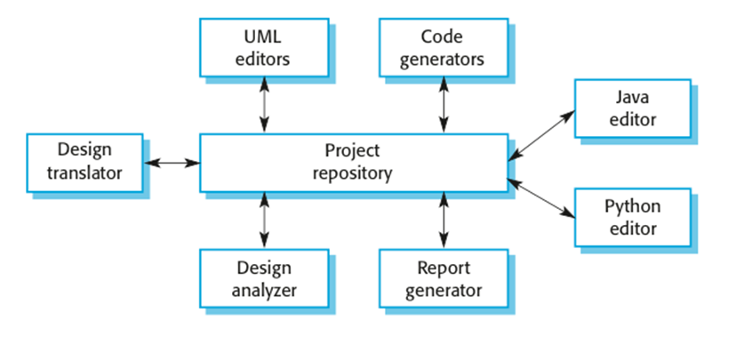
A repository architecture for an IDE

Slide 21
A repository architecture
Given reasons for your answer, suggest an appropriate structural model for the following systems:
A robot floor-cleaner (standalone system) that is intended to clean relatively clear spaces such as corridors. The cleaner must be able to sense walls and other obstructions.

Slide 22
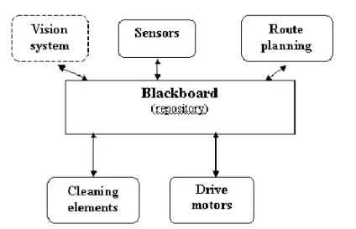
A repository architecture
A robot floor-cleaner that is intended to clean relatively clear spaces such as corridors. The cleaner must be able to sense walls and other obstructions.

Slide 23
A repository architecture
A robot floor-cleaner that is intended to clean relatively clear spaces such as corridors. The cleaner must be able to sense walls and other obstructions.
The most appropriate model is a repository model, with each of the subsystems (wall and obstacle sensors, path planning, vision (perhaps), etc.) placing information in the repository for other subsystems to use.
Robotic applications are in the realm of Artificial intelligence, and for the AI systems such as this, a special kind of repository called a blackboard (where the presence of data activates particular subsystems) is normally used

Slide 24
Plug-In Architecture
Many people are worried about privacy, whether it’s protecting their banking data, passwords, or making sure no one is reading their messages or emails. One way to ensure privacy protection is via encryption, and many software programs do so.
Most encryption applications are installed in our browser (Chrome, Mozilla, Explorer, etc.) as an add-on: a module that works on top of the browser for any communication and encrypts it. This application is called a plug-in.

Slide 25
Plug-In Architecture
A plugin architecture is an architecture that will call external code at certain points without knowing all the details of that code in advance.
A plug-in is a bundle that adds functionality to an application, called the host application, through some well-defined architecture for extensibility. This allows third-party developers to add functionality to an application without having access to the source code.
This also allows users to add new features to an application just by installing a new bundle in the appropriate folder.

Slide 26
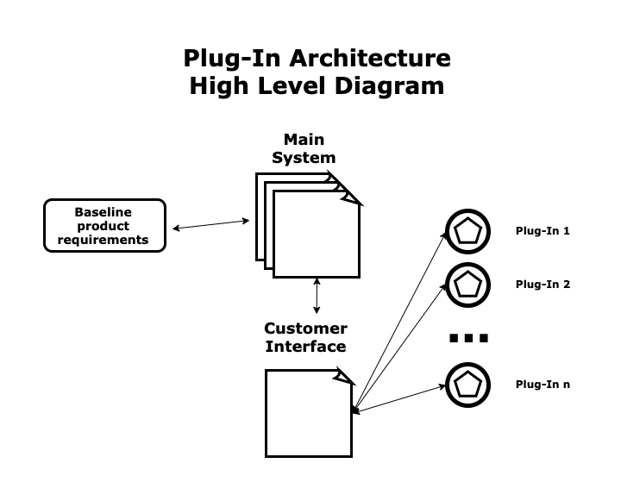
Plug-In Architecture

Slide 27
Plug-In Architecture
A standard plug-in architecture has four parts:
Baseline product requirements: This is the set of minimal requirements that define the application, determined at the beginning of the development process when an initial set of features were included in the product.
Main system: This is the application we plug the plug-ins to. The main system needs to provide a way to integrate plug-ins, and therefore will slightly vary the original baseline product to ensure compatibility.
Customer Interface: This is the module that interacts with the customer, for example, a web browser (Chrome, Mozilla, etc.).
Plug-ins: These are add-ons that enlarge the minimal requirements of the application and give it extra functionality.

Slide 28
Plug-In Architecture
There are several advantages to using plug-in architecture:
The plug-in architecture is the best way to add particular functionality to a system that was not initially designed to support it.
This architecture removes limits on the amount of functionality an application can have. We can add infinite plug-ins (The Chrome browser has hundreds of plug-ins, called extensions).
No rewriting the system.
There are also a few key disadvantages:
Plug-ins can be a source of viruses and attacks from external players.
Having many plug-ins in an application may affect its performance.
Plug-ins frequently crash with each other and produce malfunctions in the main system.

Slide 29
Plug-In Architecture
Real-World Example
SendSafely (sendsafely.com)
Mailvelope (mailvelope.com)
Rapportive (rapportive.com) connects LinkedIn to your browser.
Trello (trello.com) connects Trello to your browser.
Encryption software

Slide 30
Case-Study: Solving a Business Problem With Plug-In Architecture
Pacific is a retail website that is very successful in Southeast Asia. Here are some quick facts:
The company sells more than 64,000 items on its website, mainly to Southeast Asian customers.
About 12 items are sold every second on the website, 24 hours a day, 365 days a year.
There are heavy users of the site: users that buy many items at once, and they need to do it quickly.

Slide 31
Case-Study: Solving a Business Problem With Plug-In Architecture
What’s the Business Problem?
Each time a heavy user wants to buy many items at once, he or she must open separate browser windows for each item, causing confusion and frustration, which can stop the user from making a purchase.
For example, some users select ten items, but it the end they buy only six because they go back and forth from the shopping cart to the item pages.

Slide 32
Case-Study: Solving a Business Problem With Plug-In Architecture
How can this problem be solved?
Pacific Product Viewer, a plug-in for any browser
Pacific has developed a plug-in for Chrome called Pacific Product Viewer: when the user installs the plug-in, a list of interesting items is shown in a pop-up window, and there is no need to open multiple tabs.
This window allows the user to see many items without having to switch tabs. It is usually located in the upper-right corner of the screen.

Slide 33
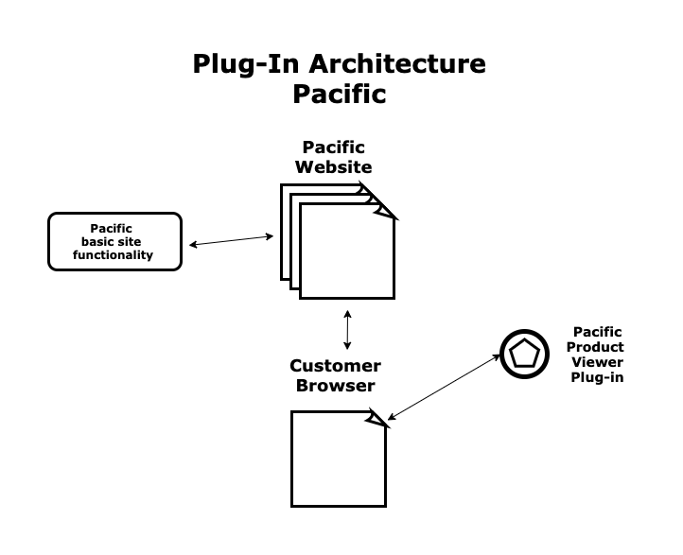
Case-Study: Solving a Business Problem With Plug-In Architecture
Pacific website: It is the main Pacific website, developed according to a minimal set of requirements.
Customer browser: Chrome, Mozilla, Explorer, etc.
Pacific Product Viewer Plug-in: The piece of software that was developed as an add-on for extra functionality.

Slide 34

Thanks to All

